Slide 1
Smart Weighing Machine
Mr. Anand Khandare(Guide)
Bhavesh Jadav
Kaushal Mania
Akash Pujari

Slide 2
Task to be completed
Task 1 | Require gathering
Task 2 | Problem Analysis
Task 3 | Identifying Components
Task 4 | Gathering information about parts
Task 5 | Designing weighing machine
Task 6 | Designing website
Task 7 | Building website
Task 8 | Connecting hardware and coding on weighing machine
Task 9 | Fabricating body of weighing machine
Task 10 | Connecting weighing machine to website
Task 11 | Testing
Task 12 | Final deployment

Slide 3
Task completed
Task 1 | Require gathering
Task 2 | Problem Analysis
Task 3 | Identifying Components
Task 4 | Gathering information about parts
Task 5 | Designing weighing machine
Task 6 | Designing website
Task 7 | Building website
Task 8 | Connecting hardware and coding on weighing machine
Task 9 | Fabricating body of weighing machine
Task 10 | Interfacing weighing machine to website
Task 11 | Testing
Task 12 | Final deployment

Slide 4
Tools and technologies that we are using
ASP.NET Core 1.0.1 For backend
Entity Framework Core for database connectivity and migrations
AdminLTE bootstrap template for front end of website
Visual Studio 2015 IDE for coding
Solidworks 2015 for CAD modelling
POSTMAN for API testing
SQL Server Management Studio 2014 for database management
Microsoft Azure for hosting purpose

Slide 5
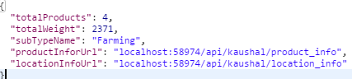
Task completed for website development
User authentication and authorization for different user role such as ‘admin’ role, ‘user’ role etc.
Validation of Form data on both client side and server side and validation of API POST data on server side
Using web API between client website and server and also between weighing machine and server
http://localhost:58974/api/bhavesh

Slide 6
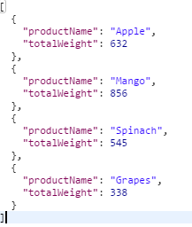
http://localhost:58974/api/bhavesh/product_info
Eg. Using following API call from weighing machine to enter data
In data base
http://localhost:58974/api/add_data/{userId}/{machineId}

Slide 7
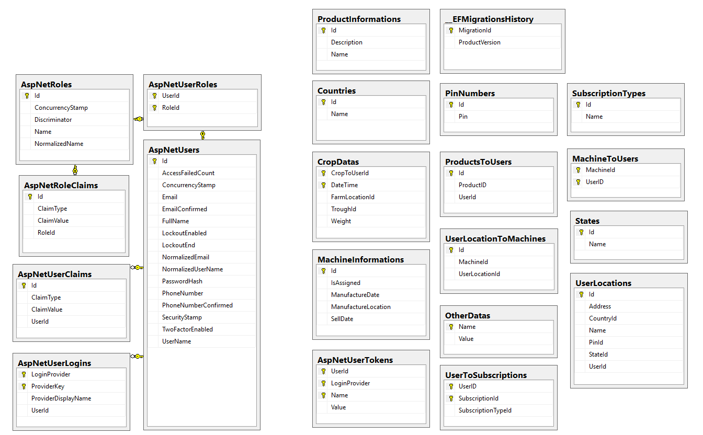
Database diagram

Slide 8
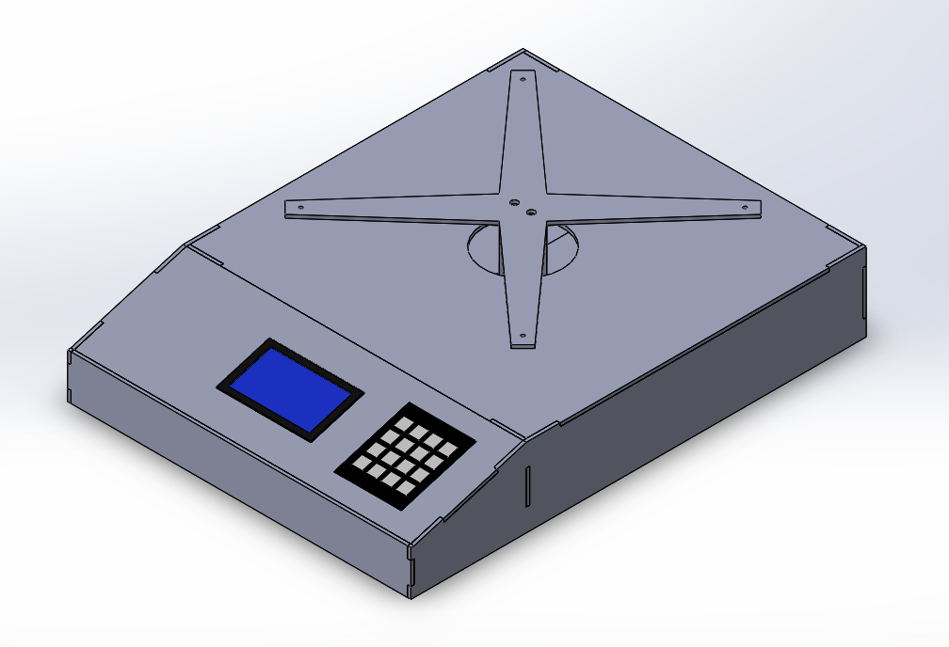
Weighing machine design

Slide 9
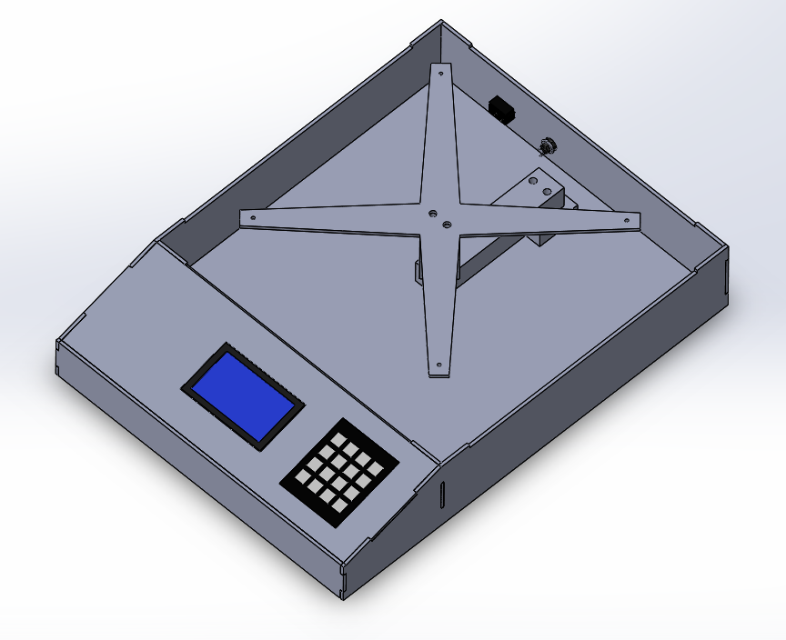
Weighing machine design

Slide 11
Challenges Faced
Designing database
Minimizing redundancy in database
Designing weighing machine body
Designing model for different types of users
Identifying different scenarios

